Slide 1

IMG Transition to Residency
Tuesday, September 29, 2026

Slide 2






































Residency Selection & Improvement Initiative
Goal: Help applicants find FM programs that align with their values and interests
Help residencies find the best applicants for their programs
Create a One-stop Information Tool
Re-imagine the
Interview Process
Improve Residency Selection and Match for IMG’s & Multi-specialty Applicants
Support Dedicated FM Applicants
Streamline the process of finding FM residency information for applicants.
Make the interview process easier, equitable, effective and efficient for residencies and applicants.
Increase the number of high-quality IMG and multi-specialty applicants who are selected for interview.
Make the matching process more efficient and economical for programs and applicants.
For more on RSII: https://www.aafp.org/residency-program-directors/residency-selection-improvement-initiative-rsii

Slide 3

1 in 3
Why IMG Recruitment & Support Matter
899
Matched FM residents were IMG’s (US & non-US IMGs combined)
2026 Main Match
FM positions remained unfilled
Before SOAP in 2026
Our opportunity through RSII
Broaden consideration of qualified applicants while strengthening programs' readiness to support IMG residents throughout training.
Source: AAFP and NRMP, 2026 Main Residency Match. Categorical and combined FM positions included.

Slide 4
Live Poll Questions

Slide 5
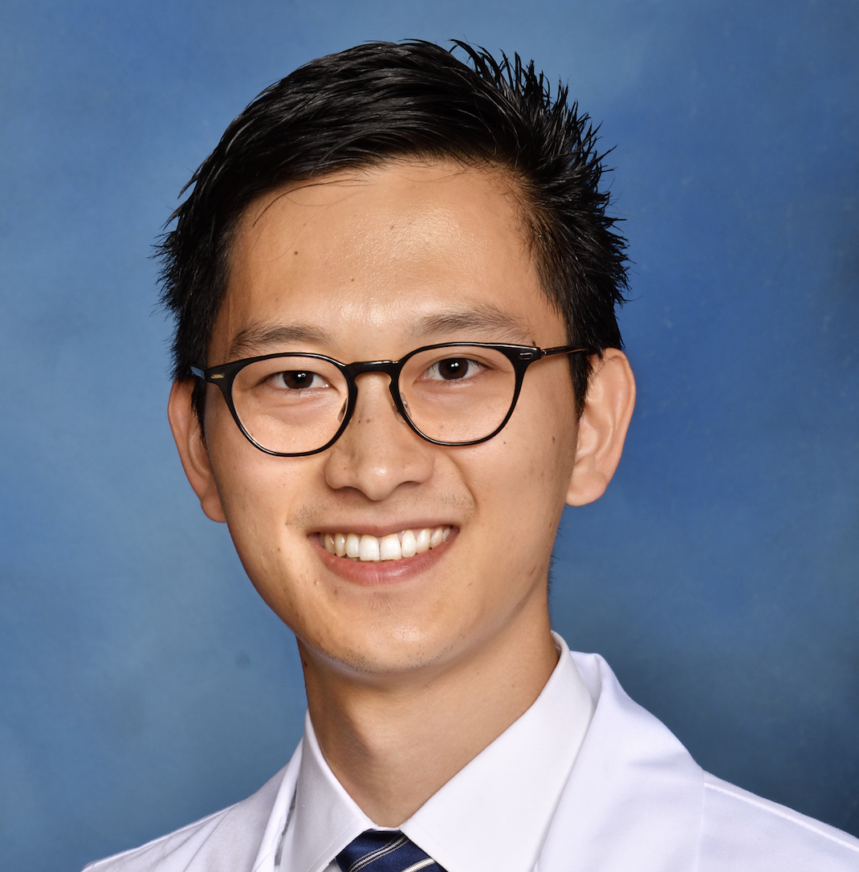
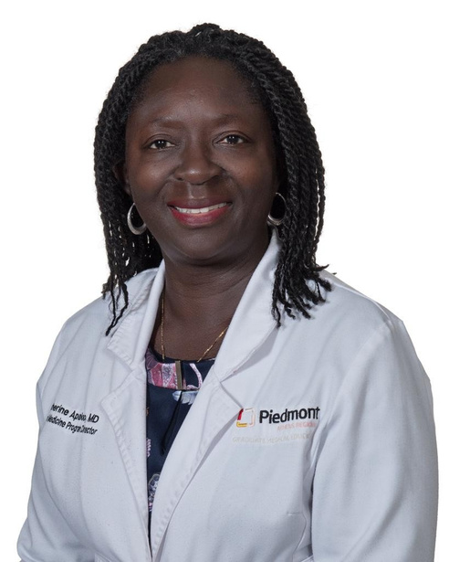
Today’s Panelists:
Kento Sonoda, MD, MPH, AAHIVS, FAAFP, FASAM
Catherine E. Apaloo, MD, FACP
Clerkship Director, Family and Community Medicine
Assistant Director, CQI
Saint Louis University School of Medicine
Senior Vice President and Chief IMG Experience Officer, Intealth

Slide 6
Objectives
Apply practical strategies and available resources to support IMG residents
Develop an actionable approach to strengthen institutional or/and program-level support for IMG residents

Slide 7
IMG: Application to Residency Graduation
Application
Match
Orientation
Residency
Attending

Slide 8
IMG: Application to Residency Graduation
Application
Match
Orientation
Residency
Attending
Webinar Part 1.
August 2026

Slide 9
Kento
Meet Kento S., a newly matched family medicine intern and international medical graduate from Japan. He is excited to start residency but is concerned about his transition to a new journey.

Slide 10
From Match Day till Orientation
Application
Match
Orientation
Residency
Attending
Webinar Part 1.
August 2026

Slide 11
Intealth’s Role in GME
Supporting IMGs Across the Continuum
Certification
Certification and verification
Resources
Data insights and workforce needs
Transition-to-residency resources
J-1 Sponsorship
Onboarding toolkits
Policy monitoring
Advocacy
Education on IMG-related topics
Engagement with policymakers
Case-level support and pattern recognition
World Directory of Medical Schools

Slide 12
The IMG Experience in GME
Essential Contributions
  Strengthen the workforce through diverse perspectives, languages, and service in high-need specialties and communities.
A Complex Transition
  Adapt to a new healthcare system, culture, and training environment.
System Barriers
  Navigate visa, credentialing, licensure, and onboarding requirements.
Belonging and Support
  Thrive through mentorship, inclusion, well-being support, and a welcoming learning environment.

Slide 13
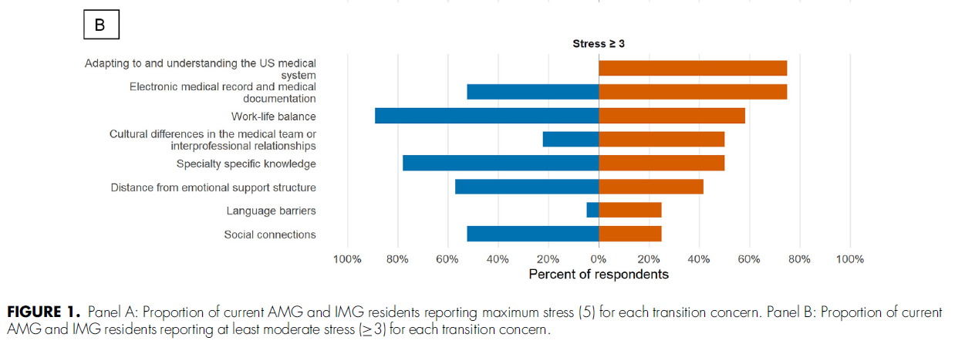

Concerns During the Transition to Residency

Slide 14
Dual Learning Curves
Adjustment to U.S. GME
System navigation and EMR proficiency
Healthcare team norms
Cultural Adaptation
U.S. social and cultural norms
Changes in family and daily life
Evaluation and feedback
Communication norms
Building belonging and community
Professional identity formation

Slide 15
Consequences for Performance and Well-Being
Clinical Efficiency
  Unfamiliar systems can reduce efficiency and increase errors
Confidence and Belonging
  Lower confidence and a weaker sense of belonging can lead to disengagement
Fair Assessment
  Adaptation challenges may be mistaken for clinical incompetence
Well-Being and Retention
  Unmet social and emotional needs can increase the risk of burnout and attrition

Slide 16

Match Day
Welcome and logistics
Before Arrival
Pre-arrival preparation
Orientation
Early integration and support
Intern Boot Camp
Inclusion and cultural adaptation
After Orientation
Ongoing support, feedback, and program improvement

Slide 17

Match Day Welcome Email
Welcome and Program Culture
  Include the program director’s welcome letter and program credo
Onboarding and Required Forms
  Provide one checklist covering demographic forms, the employment contract, and the state training permit.
  Include NPI application instructions, immigration paperwork, and vacation and days off request forms
Transition Resources
  Share the program acculturation handbook and Intealth T2R resources

Slide 18

Acculturation Handbook
Everyday Life and Community
  Housing, utilities, payroll, and taxes
  Restaurants, grocery stores, and transportation
  Places of worship and family resources
  Recreation and fitness resources
  U.S. customs, culture shock, and observed holidays
Key Documents and Applications
  Passport, visa, and I-94
  DS-2019 and initial arrival validation in SEVIS
  NPI application
How to Set up Essential Appointments
  Set up personal finances
  Obtain a Social Security number and card
  Apply for a driver’s license or state ID
  Enroll in health insurance and benefits

Slide 19


Phase 1: Pre-Arrival Preparation
6 Weeks to Orientation
Administrative Guidance
  Share visa guidance, key contacts, and steps for NPI, licensure, training permits, and employment forms.
A Practical Welcome Package
  Cover housing, banking, insurance, childcare, transportation, local services, and partner adjustment.
Virtual Orientation and Learning Resources
  Introduce the U.S. healthcare system, hospital policies, and expectations.
  Selected T2R resources: EMR and healthcare culture modules, a medical glossary, documentation guidance, and webinars
Leave and Important Program Policies
  Recognize IMG travel and family needs when planning leave
  Program dress code and etiquette

Slide 20


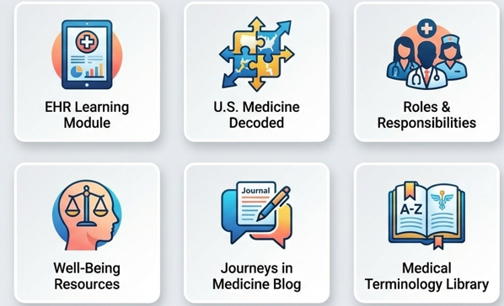

Educate. Empower. Advance.

Slide 21

US Medicine Decoded

Slide 22

Direct link to Intealth Resources
Immigration &
Administrative
Arrival procedures
EVSP welcome and consular sheets
Acculturation & Life in the US
Financial set up-bank accounts, taxes
Logistics-drivers license, transit
Program
Connectivity
Acculturation handbook
Cross-cultural experiences
Mandatory Medical Insurance
Family & daily life
Setting up WhatsApp groups
Educate. Empower. Advance. EVSP: Pre-arrival Information

Slide 23

Intern Pre-Arrival Survey
Clinical and Training Readiness
  How confident are you in your clinical and communication skills?
  How familiar are you with ACGME competencies and milestones?
Practical Needs and Interests
  How familiar are you with the city, state, U.S. income taxes, and residency benefits?
  What activities do you enjoy in your free time?
Support Networks
  Do you have a local support network?
  Can you reliably stay in touch with support outside the program?
Adapted from Grace Kajita, MD, Internal Medicine Program Director, Montefiore.

Slide 24
Orientation
Application
Match
Orientation
Residency
Attending

Slide 25
Kento – Orientation
Kento moved from Japan to a new city in the US at the beginning of June. However, he does not yet have a Social Security Number, U.S. bank account, U.S. phone number, and car. Faced with numerous logistical challenges, he is unsure where to begin as he works to establish his new life in the United States.

Slide 26
Phase 2: Early Integration and Support
Months 1–3
Structured System Orientation
  Provide IMG-focused training in EMR navigation, billing and coding, and clinical workflows
  Offer pre-start shadowing with senior residents or faculty before full clinical duties
  Cover the U.S. healthcare system, documentation, communication, handoffs, and patient safety- use patient scenarios to illustrate
Mentorship and Peer Support
  Assign a trained IMG or culturally aware faculty mentor for regular check-ins
  Establish an IMG peer network or buddy system
Protected Transition Time
  Reduce clinical duties for the first 2–4 weeks to support adjustment and personal logistics
  Support housing, banking, insurance, Social Security, DMV, primary care, and school visits

Slide 27
Practical Training During Orientation
Clinical Systems and Workflows
  Train in inpatient and outpatient EMR use
  Review residency workflows with chief residents
Clinical Skills Development
  Use ambulatory Jeopardy and clinical readiness exercises
  Practice in objective structured clinical examinations (OSCEs).
Transition to Practice
  Shadow the future team, observe workflows, and build working relationships.
IMG-Specific Acculturation
  Welcome participants and make introductions
  Discuss early steps in adapting
  Tips and tricks for logistics
  Share “what I wish I had known” stories and practical tips from peers

Slide 28
Community Orientation and Social Events
Hospital and Team Connections
  Host mentor welcome sessions & peer lunches.
  Arrange hospital tours, optionally led by nursing, and introduce hospital and clinic staff
  Locate wards, clinics, the pharmacy, lounges, cafeteria, and call rooms.
  Organize a picnic or shared meal for residents, partners, and faculty
Community and City Exploration
  Use a city scavenger hunt to explore campuses, parks, and botanical gardens
  Highlight shopping, transportation, cultural resources, and places of worship
  Introduce notable local people, events, and landmarks

Slide 29
Residency-Manual aka Intern Survival Guide
Made for residents by residents
Updated by the upcoming chief residents every year
  vetted by PD and faculty
Electronic version is emailed after Match day
Pocket version provided during orientation

Slide 30
Ongoing Training After Orientation
Early Clinical Training
  Cover acute chest pain, gastrointestinal bleeding, and COPD exacerbations in the first 6 weeks
  Review clinic visit types, team roles, and ambulatory resources
  Use intern boot camps for physical examination and equipment skills, including Panoptic and monofilament testing.
Interprofessional Connections
  Meet nutrition, physical/occupational/speech therapy, respiratory therapy, case management, and social work teams
  Build relationships through nursing-sponsored breakfasts
Ongoing Learning and Peer Support
  Protect time for monthly small-group EMR refreshers and meetings with chief residents, peer mentors, and resident groups

Slide 31


Well-Being Challenges
Bias and Social Isolation
  Cultural insensitivity and anti-immigrant discrimination involving peers, faculty, staff, or patients.
Immigration and Career Uncertainty
  Legal concerns affecting current training, future opportunities, and life beyond residency.
Personal and Financial Pressures
  Homesickness, guilt about leaving home, social isolation, and financial obligations.
Personal Perspectives (Paraphrased)
  Leaving home can bring financial strain and reluctance to ask family for help.
  Residents may question whether moving was the right decision.
  Cultural expectations can make seeking mental health support difficult.
Chen P et al. Professional Challenges of Non-U.S.-Born International Medical Graduates and Recommendations for Support During Residency Training. Academic Medicine. 2011;86:1383–1388.

Slide 32
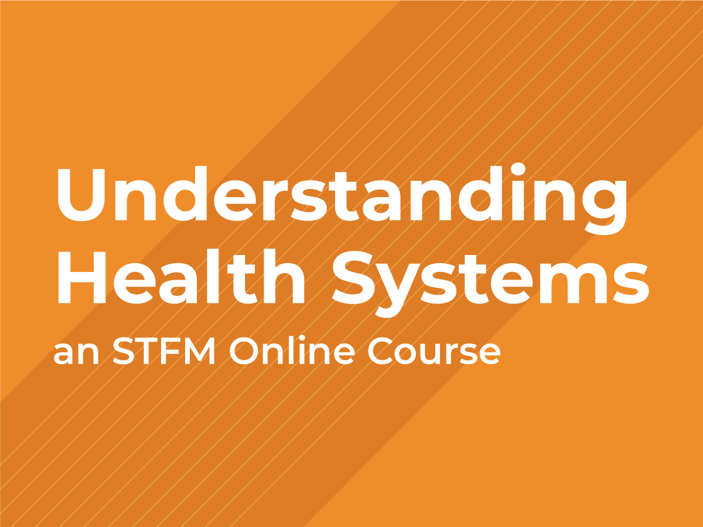
Health system navigation
The Business of Medicine
Systems and Structure
Health Systems Finance

Slide 33
EPA – Identifying/Addressing the gaps
EPA 1: Gather a history and perform a physical exam
EPA 2: Prioritize a differential diagnosis following a clinical encounter
EPA 3: Recommend and interpret common diagnostic and screening tests
EPA 4: Enter and discuss orders and prescriptions
EPA 5: Document a clinical encounter in the patient record
EPA 6: Provide an oral presentation of a clinical encounter
EPA 7: Form clinical questions and retrieve evidence to advance patient care
EPA 8: Give or receive a patient handover to transition care responsibility
EPA 9: Collaborate as a member of an interprofessional team
EPA 10: Recognize a patient requiring urgent or emergent care and initiate evaluation and management
EPA 11: Obtain informed consent for tests and/or procedures
EPA 12: Perform general procedures of a physician
EPA 13: Identify system failures and contribute to a culture of safety and improvement
Eliasz etl al. 2023.
Notes:
Eliasz KL, Nick MW, Zabar S, et al. Viewing Readiness-for-Residency through Binoculars: Mapping Competency-Based Assessments to the AAMC's 13 Core Entrustable Professional Activities (EPAs). Teach Learn Med. 2023;35(4):436-441. doi:10.1080/10401334.2022.2082432

Slide 34
Residency
Application
Match
Orientation
Residency
Attending

Slide 35
Kento – Internship
Kento finally began his residency rotations. At times, he struggled to understand slang and unfamiliar expressions. He also felt uncomfortable talking with patients who used illicit drugs. However, he hesitated to share these concerns with faculty because he worried that asking “basic” questions might negatively affect their evaluation of him.

Slide 36
Mentorship Tips in Residency (IMGs)
Create a foundation of psychological safety
Normalize the mentorship process
Separate knowledge gaps from cultural/system unfamiliarity
- Clinical
- Professional acculturation
Set regular and low-stake check-ins
Notes:
Sometimes, hesitate to disclose struggles esp. related to language or cultural barriers
Separate knowledge gaps from cultural/system unfamiliarity
This may be particularly important for IMGs. A resident might understand the medicine perfectly but not know:
how urgently nurses expect a page to be answered
when to call an attending
how to communicate disagreement with a consultant
what information is expected during rounds
how discharge planning works
what “strong ownership” looks like in a U.S. residency

Slide 37
Mentorship Tips in Residency: IMGs
Ask
Clarify
Normalize
Respond
Reflect
Notes:
“Ask before assuming; clarify what is hidden; normalize the learning process; respond to individual needs; and reflect on your own role as a mentor.”

Slide 38
Phase 3: Inclusion and Ongoing Support
Months 3–12 and beyond
Culture and communication
  Train faculty and IMGs in cultural humility, bias awareness, U.S. team norms, and supportive language and accent feedback; include global perspectives.
Community and belonging
  Build connections through social events, local cultural groups, and Employee Resource Groups.
Family support and well-being
  Offer childcare and partner resources, confidential wellness support, and flexibility for travel and family needs.
Career and immigration support
  Provide research and scholarly activity coaching, future career planning, and guidance on visa and immigration concerns.

Slide 39
Phase 4: Ongoing Program Improvement
Regular Check-ins and Longitudinal Support
  Embed mentor and leadership check-ins and annual reviews throughout training; sustain connection through alumni networks.
Program Leadership and Improvement
  Track retention, well-being, and career progression; use feedback and outcome data to identify gaps and improve support.
Survey and Feedback Administrators
  Use anonymous surveys and open forums to understand IMG experiences, evolving needs, and suggestions.
Make the Hidden Curriculum Explicit
  Clarify unspoken program norms, including dress expectations, forms of address, and use of titles.

Slide 40
Transition from Residency to Attending
Application
Match
Orientation
Residency
Attending

Slide 41
Kento – PGY-3
With support from faculty and colleagues, Kento successfully progressed to PGY-3. As he approaches the completion of residency, he hopes to remain in the United States to continue his career. However, he is unsure where to start or whom to approach for guidance on navigating the next steps.

Slide 42
Transition from Residency to Attending
J-1 Visa
Home Country
Needs to start a job search/interview May-June (PGY-2)
Stay in the US
Conrad 30
J-1 Waiver
HHS
O-1 Visa

Slide 43
Transition from Residency to Attending
H-1B Visa
Home Country
Stay in the US
H-1B Visa

Slide 44
IMG: Application to Residency Graduation
Application
Match
Orientation
Residency
Attending

Slide 45
Key Take-Home Messages
Embed continuous IMG support into training—not just at key transitions
Provide intentional mentorship with regular follow-up
Build cultural humility through faculty and interprofessional team development
Use data to guide continuous quality improvement (CQI)
Leverage Intealth resources and collaborate with other programs

Slide 46

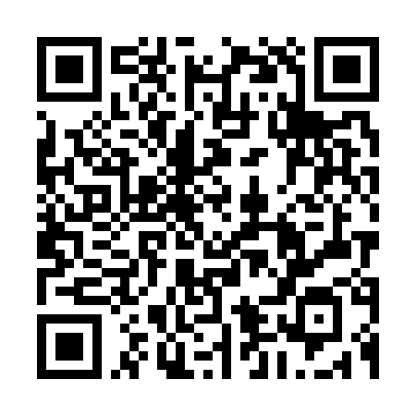
Toolkit with Samples
Welcome Packet checklist
Resident Survival Guide and Acculturation Handbook
Orientation schedule examples
Social activity examples
Scavenger Hunt and Jeopardy samples
How to apply for an NPI number
Sample beginning of year OSCE
Essential history taking skills
Incoming Intern survey

Slide 47

Any Questions?

Slide 48
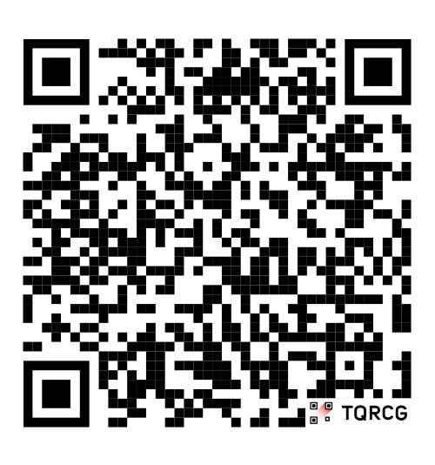
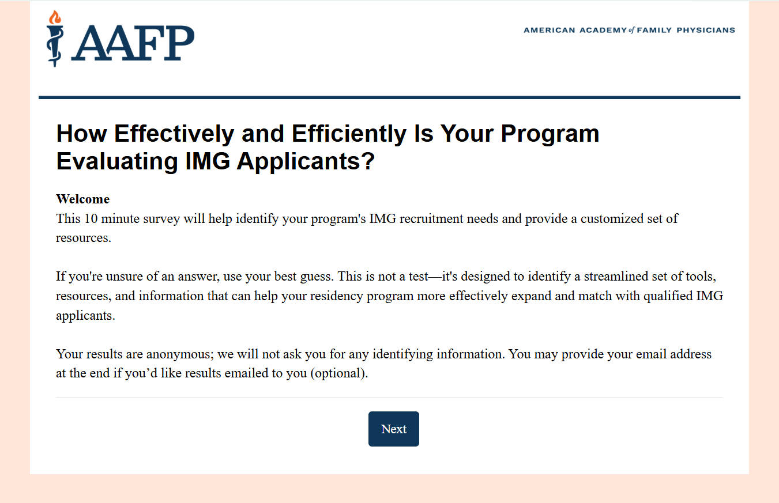
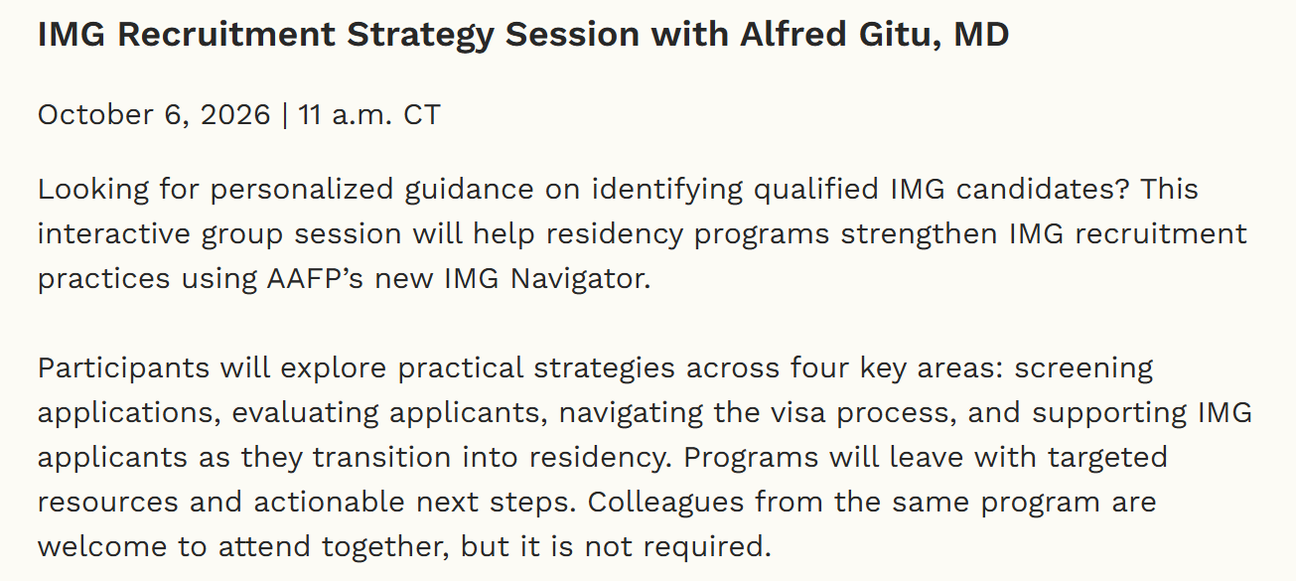
Try the New RSII IMG Navigator!
A quick, 7-minute tool designed to gauge IMG recruitment practices
Join AAFP’s free Residency Program Solutions (RPS): Mini Group Consult Session
Explore: https://survey.alchemer.com/s3/8924005/IMG-Navigator
Register: https://www.aafp.org/residency-program-directors/residency-program-solutions/rps-mini-group-consults

Slide 49
Thank you!
Slides, recordings, and additional resources will be posted on
our AFMRD website later this week.
https://www.afmrd.org/webinars

