Slide 1

EPA Graphics
AFMRD EPA TASK FORCE

Slide 2
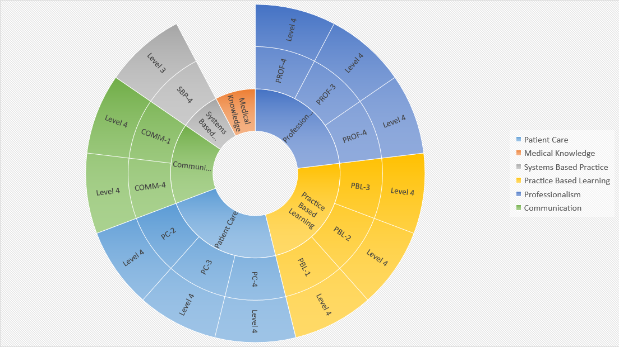
Provide a usual source of comprehensive, longitudinal medical care for people of all ages.
1

Slide 3
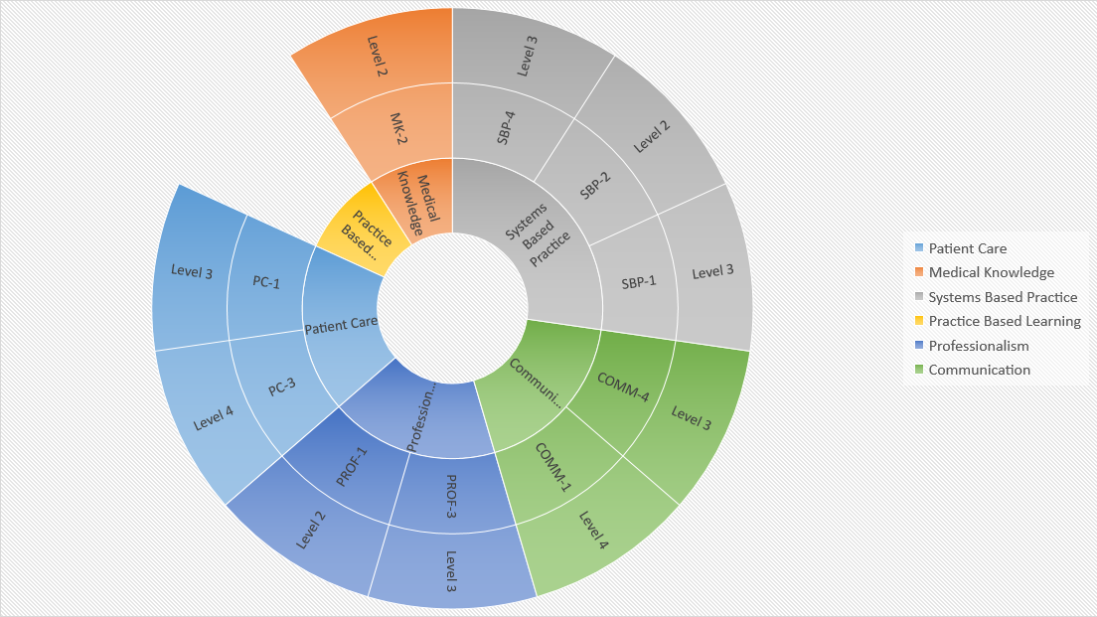
Care for patients and families in multiple settings.
2

Slide 4
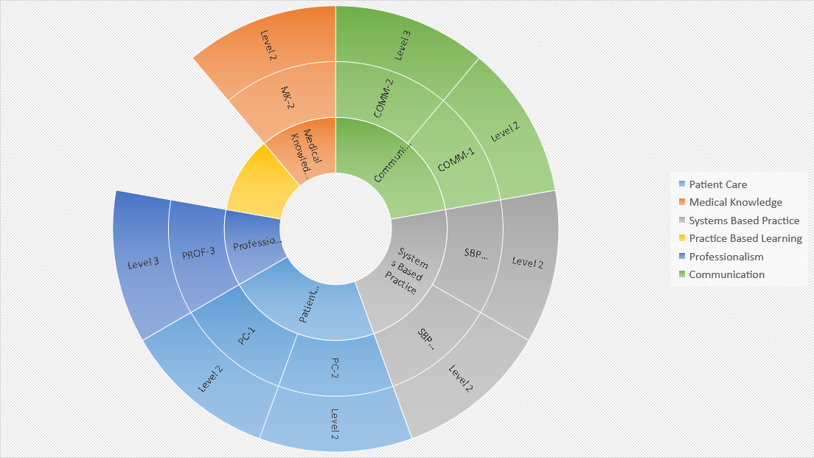
Provide first-contact access to care for health issues and medical problems.
3

Slide 5
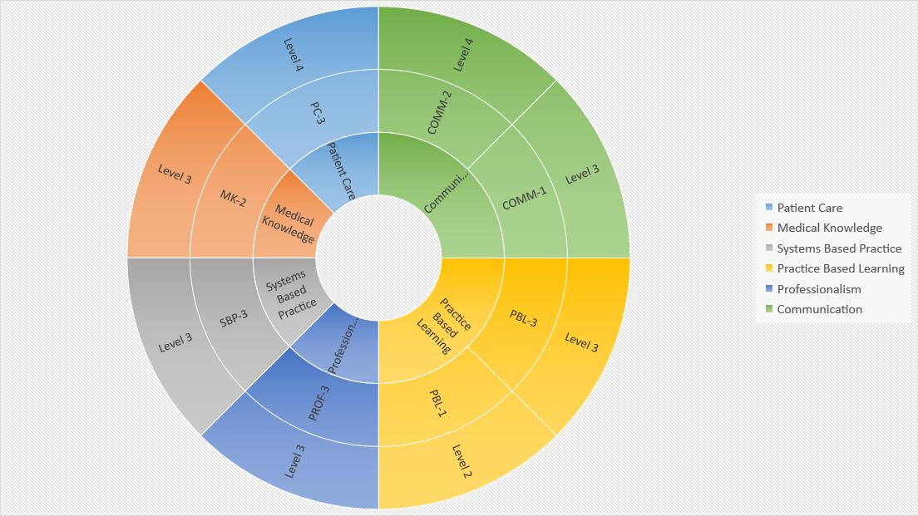
Provide preventive care that improves wellness, modifies risk factors for illness and injury, and detects illness in early, treatable stages.
4

Slide 6
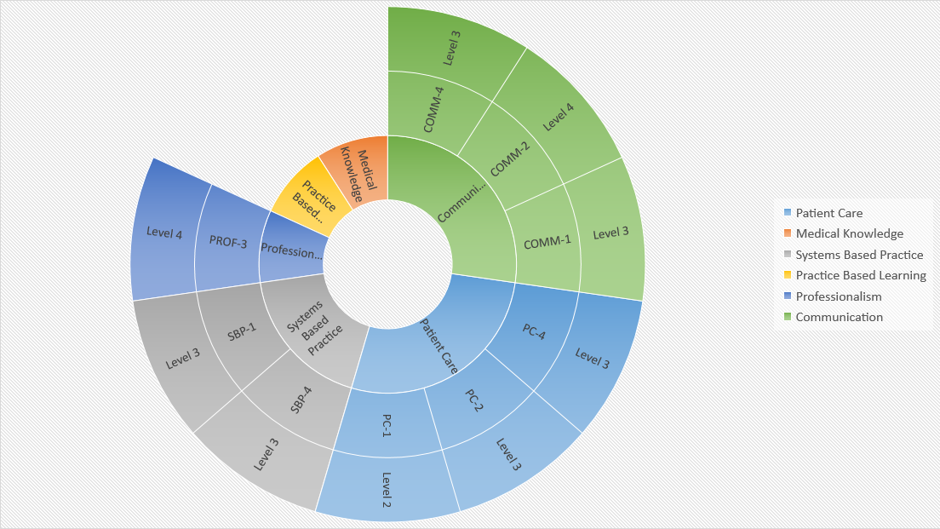
Provide care that speeds recovery from illness and improves function.
5

Slide 7
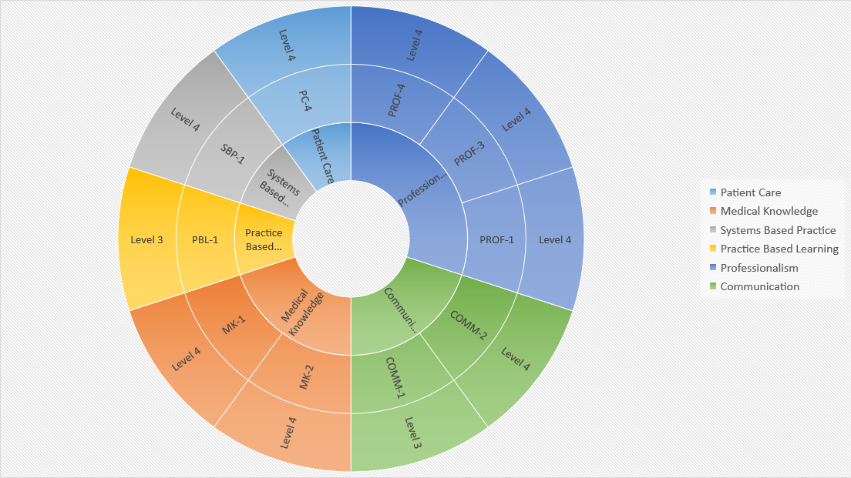
Evaluate and manage undifferentiated symptoms and complex conditions.
6

Slide 8
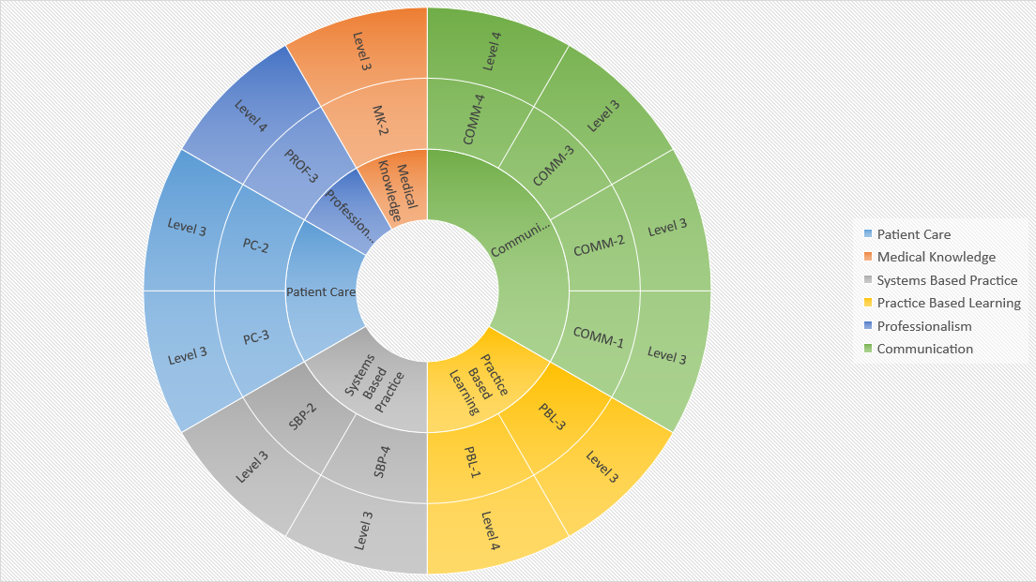
Diagnose and manage chronic medical conditions and multiple co-morbidities.
7

Slide 9
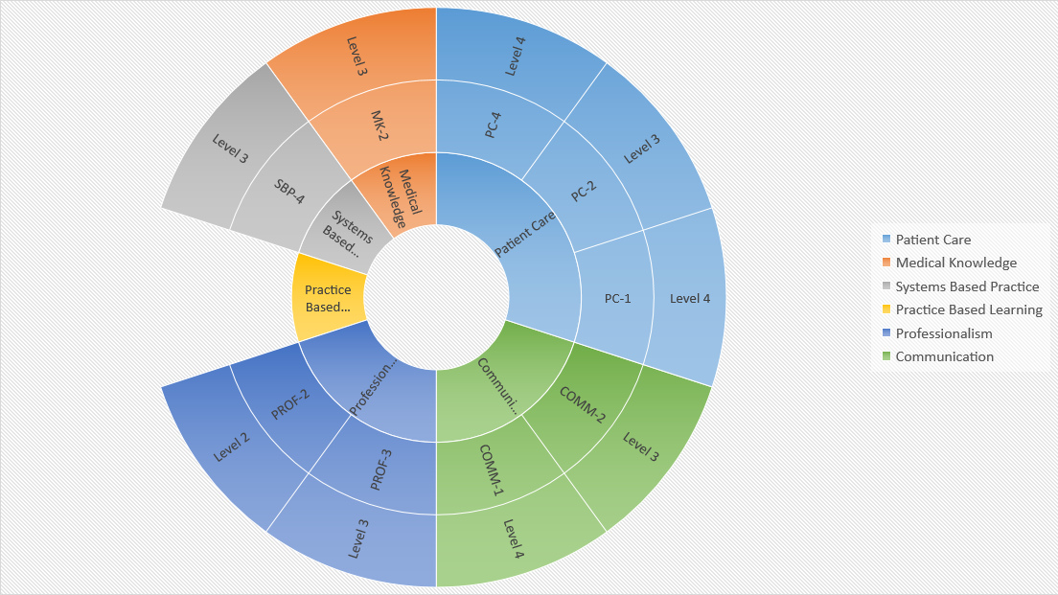
Diagnose and manage mental health conditions.
8

Slide 10
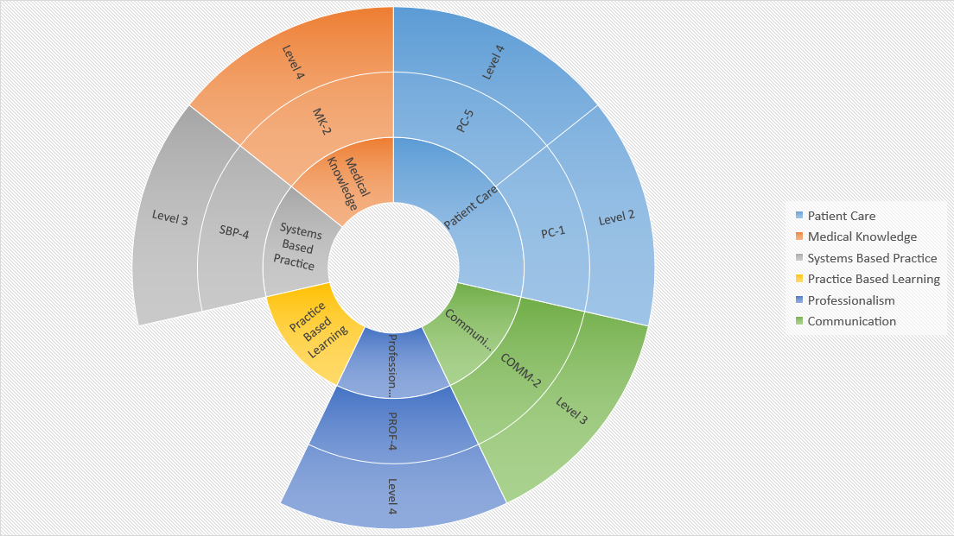
Diagnose and manage acute illness and injury.
9

Slide 11
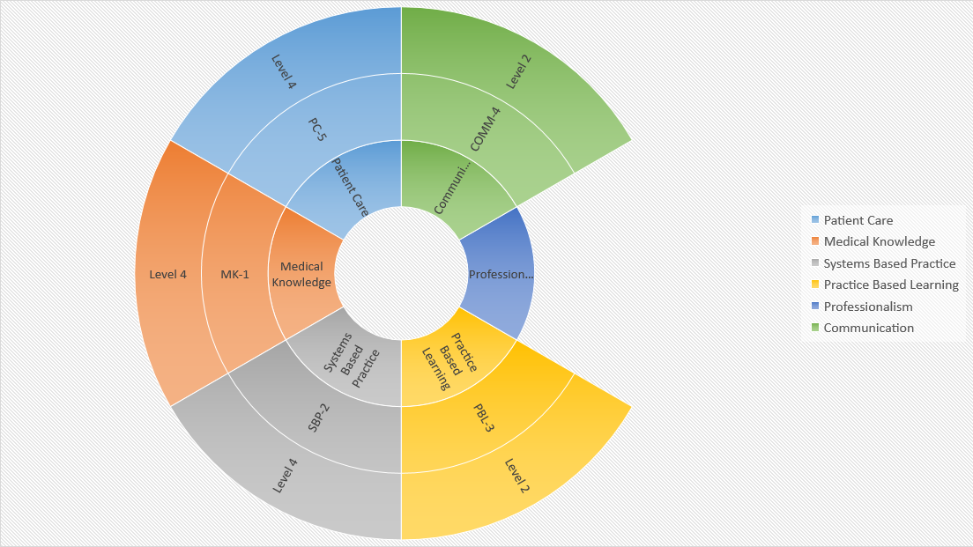
Perform common procedures in the outpatient or inpatient setting.
10

Slide 12
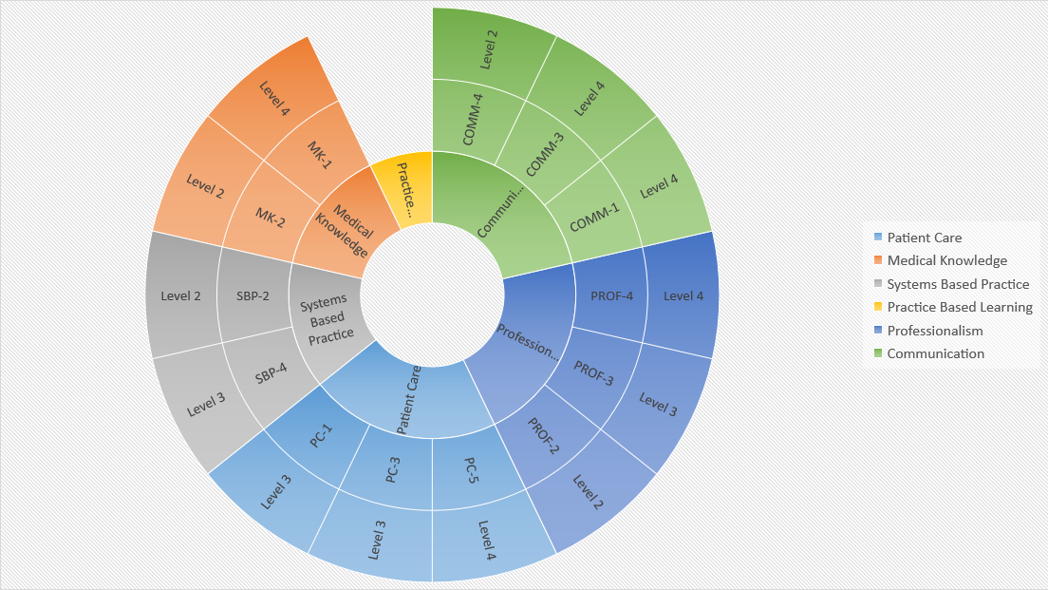
Manage prenatal, labor, delivery and post-partum care.
11

Slide 13
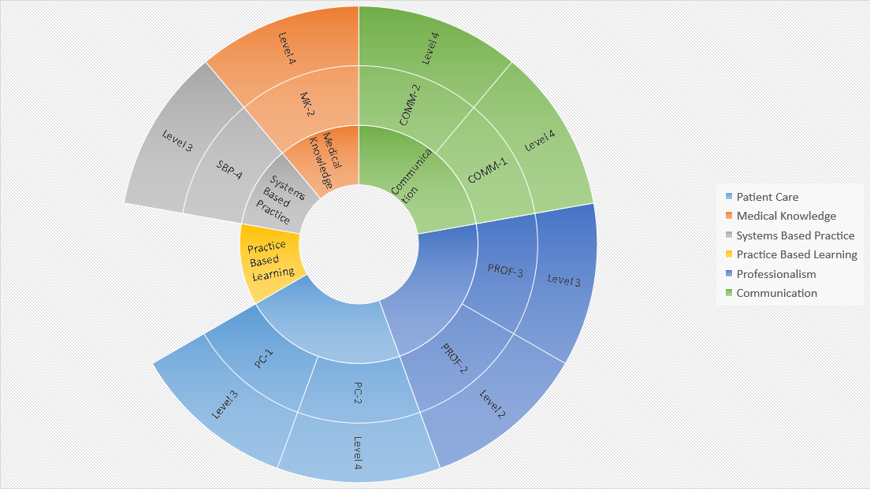
Manage end-of-life and palliative care.
12

Slide 14
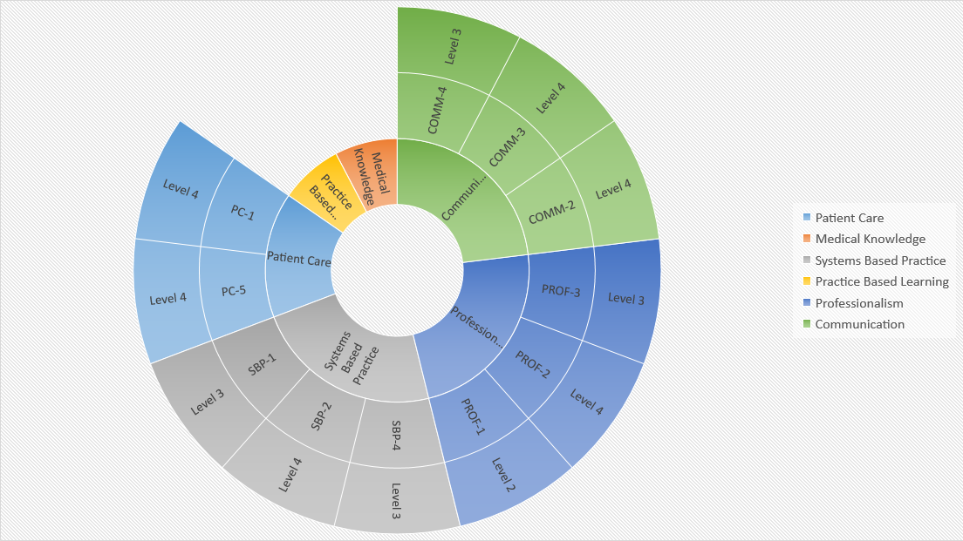
Manage inpatient care, discharge planning, transitions of care.
13

Slide 15
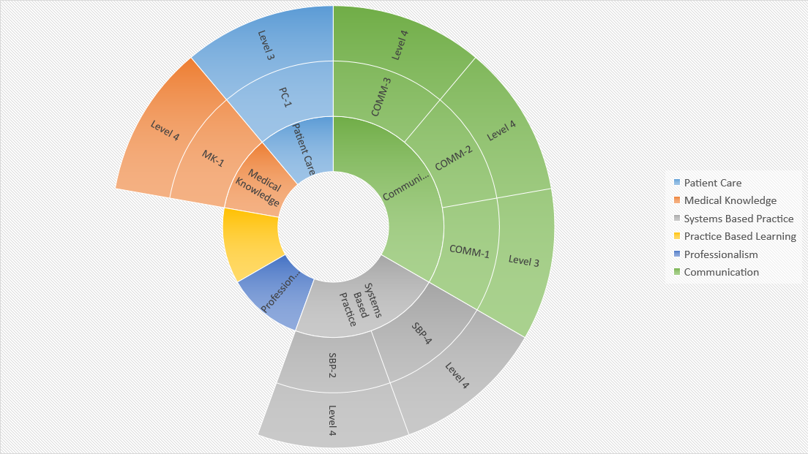
Manage care for patients with medical emergencies.
14

Slide 16
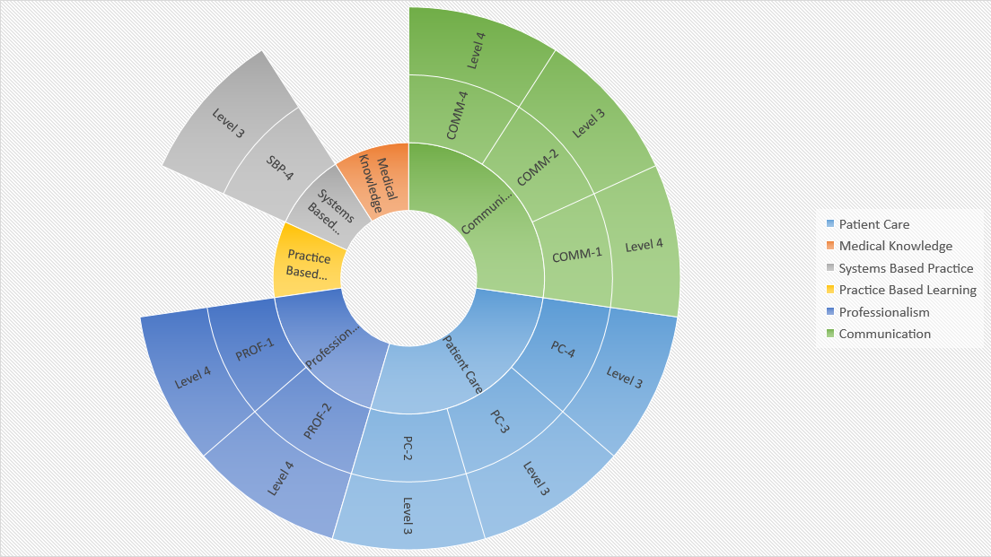
Develop trusting relationships and sustained partnerships with patients, families and communities.
15

Slide 17
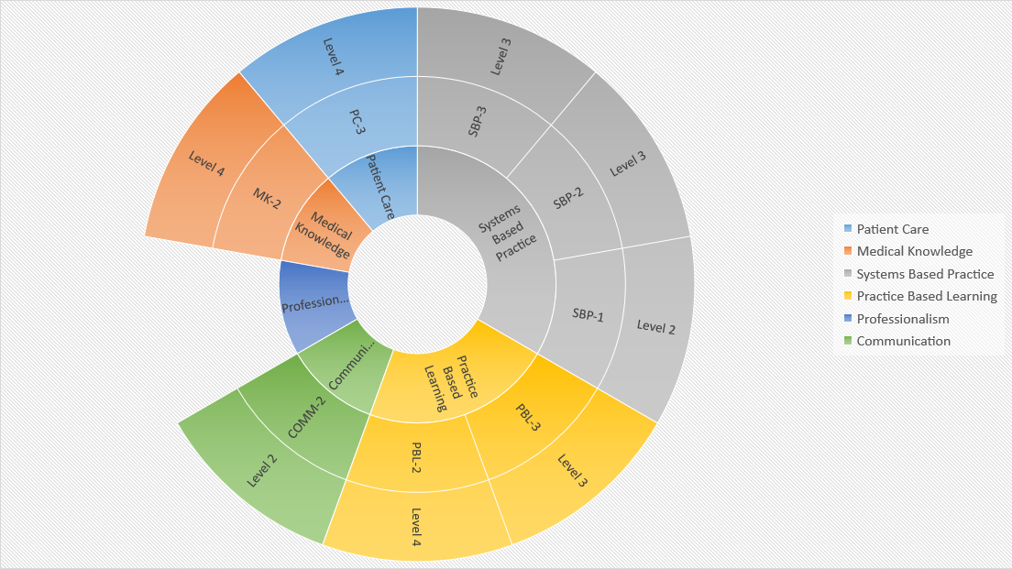
Use data to optimize the care of individuals, families and populations.
16

Slide 18
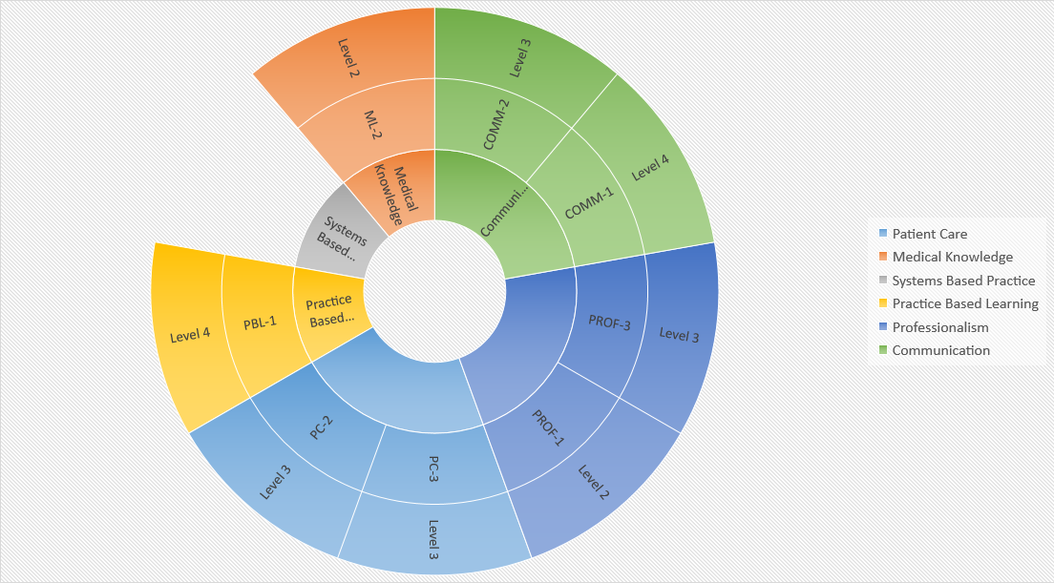
In the context of culture and health beliefs of patients and families, use the best science to set mutual health goals and provide services most likely to benefit health.
17

Slide 19
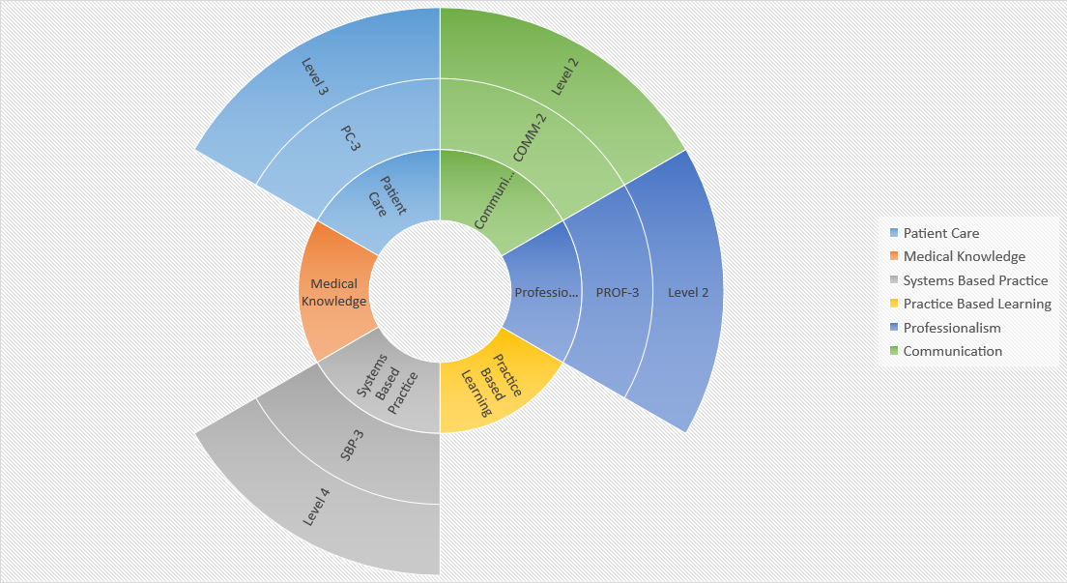
Advocate for patients, families, and communities to optimize health care equity and minimize health outcome disparities
18

Slide 20
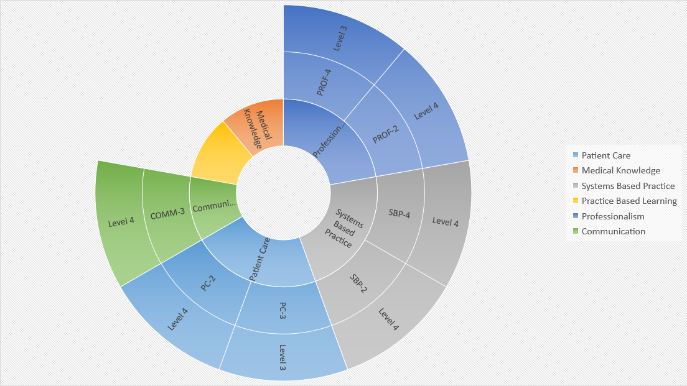
Provide leadership within interprofessional health care teams.
19

Slide 21
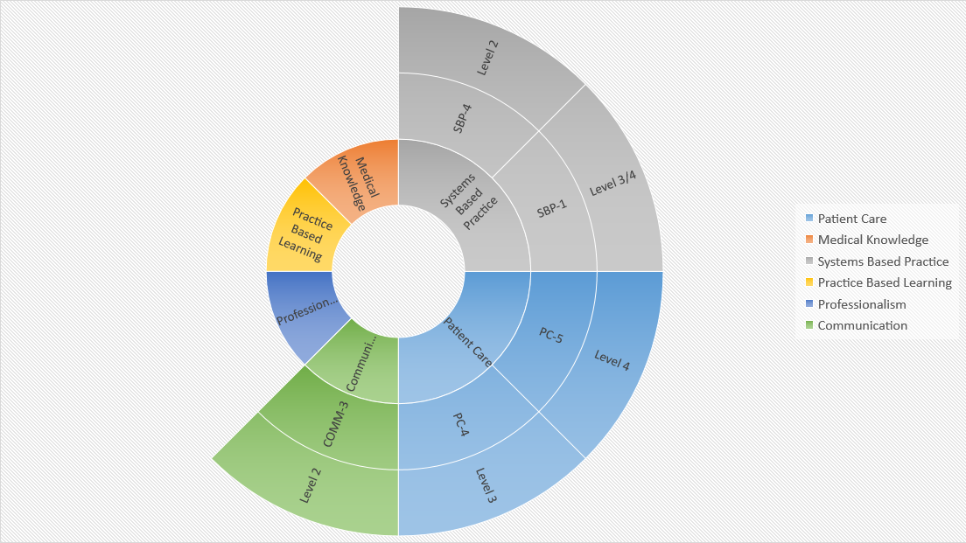
Coordinate care and evaluate specialty consultation as the condition of the patient requires.
20

